Slide 1
CIS532v2: Estimating Probability Distributions
Live Session 1
Ernest Green
Notes:
Note: This presentation is based substantially on work done by Melynda Eden, eCornell Machine Learning Facilitator, for version 1 of this course.

Slide 2
Today’s Live Session
CIS532v2 - Course Info
Bayes Optimal Classifier, MLE, Naive Bayes
Pre-project coding exercises
Reminder about avoiding loops whenever possible

Slide 3
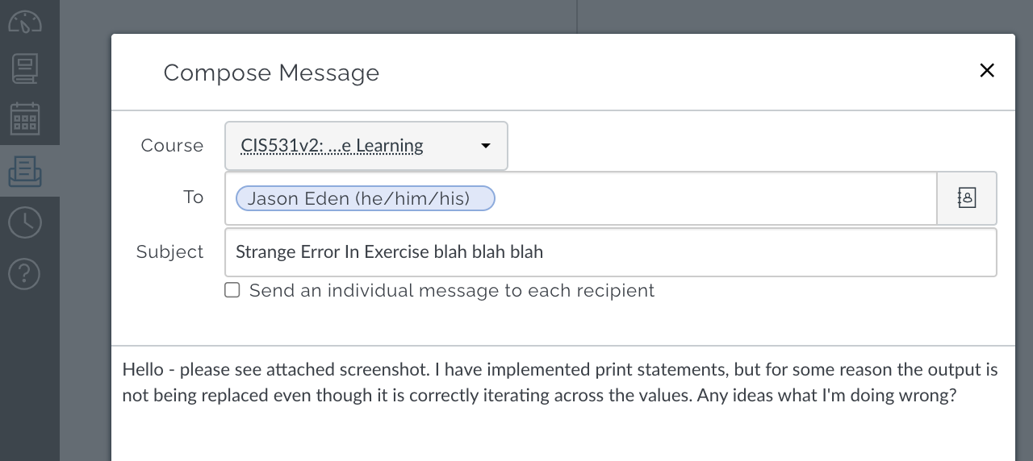

Ernest Green, Course Facilitator
How to get assistance:
Private message me through Canvas
Preferred: You can also post questions to the Q&A discussion board

Slide 4
Additional Resources
Lecture 7 "Estimating Probabilities from Data: Maximum Likelihood Estimation" -Cornell CS4780 SP17
https://www.youtube.com/watch?v=RIawrYLVdIw
Machine Learning Lecture 8 "Estimating Probabilities from Data: Naive Bayes" -Cornell CS4780 SP17
https://www.youtube.com/watch?v=pDHEX2usCS0
Machine Learning Lecture 9 "Naive Bayes continued" -Cornell CS4780 SP17
https://www.youtube.com/watch?v=VDK0nkjFh5U
Machine Learning Lecture 10 "Naive Bayes continued" -Cornell CS4780 SP17
https://www.youtube.com/watch?v=rqB0XWoMreU
Machine Learning Lecture 11 "Logistic Regression" -Cornell CS4780 SP17
https://www.youtube.com/watch?v=GnkDzIOxfzI

Slide 5
Avoid the Appearance of Plagiarism
Key points:
Show your work - comment out, do not delete, mistakes, print statements, test cells, etc. Messy notebook that shows original thought is better than pristine code that happens to look like someone else’s work
Reference helpful websites - put links to discussion boards, Q&A forums (Stack Overflow, etc.) that contained information you found useful in developing your code
When in doubt, ask your facilitator!

Slide 6
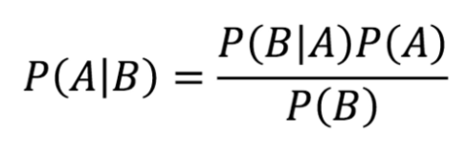
Statistics Refreshers
Bayes’ Rule
Chain Rule

Slide 7
Bayes Basics
The quick proof of Bayes' theorem
https://www.youtube.com/watch?v=U_85TaXbeIo
Bayes theorem
https://www.youtube.com/watch?v=HZGCoVF3YvM
Naive Bayes, Clearly Explained!!!
https://www.youtube.com/watch?v=O2L2Uv9pdDA
Notes:
There are all sorts of resources out there online if you need a more comprehensive statistics refresher. Personally, I like the Khan Academy videos on statistics. If it’s been awhile since you’ve thought about or used statistics, Khan Academy has a statistics course, as well as an AP statistics course with several videos, and you can watch all of them, or pick and choose the ones that you think will be helpful. I also like the 3Blue1Brown series of videos on various math topics. Here are a few links that I found helpful on Bayes. There are other helpful resources out there if you need a refresher on statistics in general or on Bayes.

Slide 8
Distributions
Gaussian (a.k.a. Normal)
Continuous outcome variables
Bell curve, symmetric at center
Values for mean = mode = median
Binomial
Two discrete outcome variables (ex: coin flips)
Other distribution types https://www.unf.edu/~cwinton/html/cop4300/s09/class.notes/DiscreteDist.pdf
Notes:
Note: The link goes into detail about how Bernoulli and Binomial distributions are related, but different.

Slide 9
Estimating Distributions from Data
Bayes Optimal Classifier - Bayes Theorem applied, but only works if you know the actual distribution of all data

Slide 10
Estimating Distributions from Data
Bayes Optimal Classifier - Bayes Theorem applied, but only works if you know the actual distribution of all data
Actual data distribution is approximately 2:1

Slide 11
Estimating Distributions from Data
Bayes Optimal Classifier - Bayes Theorem applied, but only works if you know the actual distribution of all data
If we happen to sample from here, appears to be 4:5

Slide 12
Estimating Distributions from Data
Bayes Optimal Classifier - Bayes Theorem applied, but only works if you know the actual distribution of all data
If we happen to sample from here, appears to be 5:1

Slide 13
Estimating Distributions from Data
Bayes Optimal Classifier - Bayes Theorem applied, but only works if you know the actual distribution of all data
If we happen to sample from here, appears to be 3:1

Slide 14
Estimating Distributions from Data
Bayes Optimal Classifier - Bayes Theorem applied, but only works if you know the actual distribution of all data
...and you never actually know the underlying distribution of your data

Slide 15
Maximum Likelihood Estimation
Step 1: Estimate the distribution of your data based on known parameters
Coin flip: it’s either heads or tails, so binomial distribution
Take the data you observe, tweak those parameters until what you observed becomes as likely as possible (becomes maximized)

Slide 16

Estimating Theta
In a binomial distribution, theta is the likelihood of a target outcome
The probability of theta for given data approximately equals theta to the power of an observed outcome times 1-theta to the power of the other outcome

Slide 17
Simplifying Theta
But first… a note about log values

Slide 18


The Case for Log Values - Simplification
Log (natural log) is the inverse of Exponential
Has some interesting properties that can be used to simplify calculations:
log(a * b) = log(a) + log(b)
log(a / b) = log(a) - log(b)
==

Slide 19
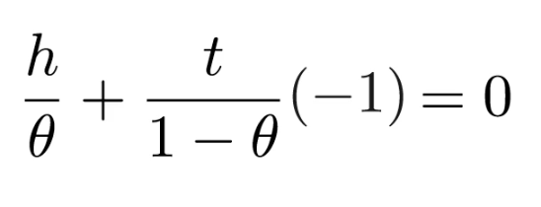
Simplifying Theta - First Derivative
To maximize a function, take the first derivative and set it equal to zero
->
If you’re rusty on derivatives of logs (note - log and natural log are used interchangeably in portions of the course material, and numpy.log() refers to natural log): https://www.youtube.com/watch?v=Dp9sgIvaKPk

Slide 20
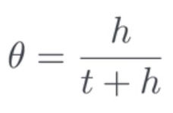
Simplifying Theta - Solve for Theta
->

Slide 21
Simplifying Theta - Solve for Theta
...which makes intuitive sense, but now we have the mathematical underpinning.
->

Slide 22
Smoothing - Why?
Avoids “divide by 0” or “multiply by 0” errors
Corrects for non-representative samples

Slide 23
Smoothing - Accounting for Unlikely Samples
Avoids “divide by 0” or “multiply by 0” errors
Corrects for non-representative samples
What happens if this is the data we happen to get? Given what we know, does a 7:0 ratio make sense?

Slide 24
Smoothing - Laplace (+1)
Avoids “divide by 0” or “multiply by 0” errors
Corrects for non-representative samples
Whatever data is sampled, simply add one to each category, so we impute an 8:1 ratio instead of 7:0

Slide 25
Smoothing - Beware of Assumptions
If our data ratio really was 40:1 or similar, our +1 smoothing would hinder our progress in getting to the actual distribution instead of helping!

Slide 26
Additional Reading
Maximum A Posterior (MAP)
https://wiseodd.github.io/techblog/2017/01/01/mle-vs-map/
Basically: MLE makes distribution assumptions, whereas MAP assumes prior knowledge is used to determine theta value

Slide 27
Classification with the Naive Bayes Algorithm
MLE Curse of Dimensionality
The higher d, lower chance of there being an exact match
Thus, lots of cases where no probability exists
Naive Bayes Assumption
“Naively” assume that all data points conditionally independent, even if you know they’re not
Allows us to use chain rule to determine probabilities - exact match not required for labeling
Notes:
Module 2 goes into the curse of dimensionality; basically, the more dimensions in your dataset, the less likely it is that any two feature vectors will match exactly. Using standard Bayes, you can only construct probabilities for vectors whose exact combination of features are represented in the training set. So, if x is high dimensional, we can’t use MLE to estimate P of y given x, meaning, in high dimensions, we can’t use MLE to label a test data point, because there won’t be an exact match in the training data.
To solve this problem, the course introduces the **Naive** Bayes Assumption. If you haven’t already done so, be sure to view the Naive Bayes Assumption video and the Naive Bayes Classifier video in module 2. These videos explain how the Naive Bayes classifier decomposes a single high dimensional probability estimation problem into many 1-dimensional estimation problems by assuming the features are conditionally independent given the class label. The videos explain that if we can assume conditional independence, P of x given y decomposes into a product over all the dimensions of the probability of every single feature. So, you calculate the probabilities of the labels given the observed data, one dimension at a time using Bayes' Rule. Then, you choose y such that this probability is maximized, considering each dimension of the feature vector independently.

Slide 28
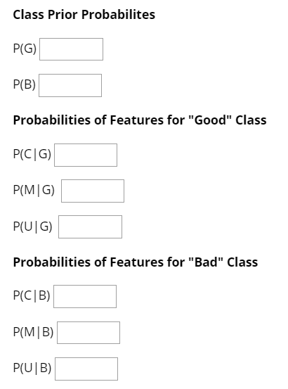
Naive Bayes in Action
Binary features:
C = “Guy wears a cape.”
M = “Guy wears a mask.”
U = “Guy wears his underwear outside his pants”
Labels:
G = “Guy is good”
B = "Guy is bad"
Notes:
At the end of module 2 is an ungraded activity ‘Naive Bayes in Action’, where you are asked to calculate probabilities. This exercise is pretty straightforward, and after you give it a try, you can view the solutions if needed.
For this exercise, you’re trying to predict if someone is a good guy or a bad guy based on whether they wear a cape, a mask, and / or underwear outside of their pants. First, you calculate the prior class probabilities, and then the probabilities of features for the “good” class, and probabilities of features for the “bad” class. Then, there are three questions to answer. So, this is ungraded, and you can make multiple attempts at this without any penalties.

Slide 29
Naive Bayes in Action
Question 1: Estimate the probability that Suzie’s date wears a mask and cape, given that he is good, using the Naive Bayes assumption.
P (M,C|G)
Multiply P (M|G) by P (C|G)
Question 2: Before Suzie meets her date, what’s the probability he is wearing a mask and cape (she does not know if he is good or bad)? (Use NB Assumption)
P (M,C) = P(M,C|G)P(G) + P(M,C|B)P(B)
Notes:
So, let’s take a quick look at the questions.
Question 1: Estimate the probability that Suzie’s date wears a mask and cape, given that he is good, using the Naive Bayes assumption. They give you the formula probability of mask and cape, given the “good” class. So, you would simply multiply the probabilities that you figured out - multiply the probability of wearing a mask given that he is good by the probability of wearing a cape given that he is good.
Question 2: Before Suzie meets her date, what’s the probability he is wearing a mask and cape (she does not know if he is good or bad)? So, using the formula that they give you, you would multiply the probability of wearing a mask given that he is good by the probability of wearing a cape given that he is good and multiply this by the probability of the “good” class, and then do the same for these probabilities for the “bad” class, and add them together.

Slide 30
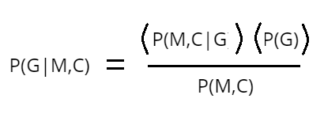
Naive Bayes in Action - Question 3
Using Naive Bayes assumption and Bayes’ Rule, predict the probability that he is good if he wears a mask and a cape. Hint: P (G|M,C)
Machine Learning Lecture 9 "Naive Bayes continued" -Cornell CS4780 SP17
https://www.youtube.com/watch?v=VDK0nkjFh5U
Notes:
The third question is not as straight forward. Using Naive Bayes assumption and Bayes’ Rule, predict the probability that he is good if he wears a mask and a cape. So, to solve this one, you multiply the probability of wearing a mask given that he is good by the probability of wearing a cape given that he is good by the probability of the “good” class, and then divide that by the product of the probability that he is wearing a mask regardless of class and the probability that he is wearing a cape regardless of class.
Dr. Weinberger goes through this exercise with slightly different questions in the in person class about 7 or 8 minutes into the video - the link is here on the slide. So, check that out if you’d like a more in depth explanation of that exercise.

Slide 31


Reminder: Avoid Loops, Utilize Indexing and Slicing
Matrix X
Matrix Y
ind = X[condition]
subset_Y = Y[ind]
I, D = findknn(xTr, xTe, k)
yTe = yTr[I]
ind = Y[condition]
subset_X = X[ind]
Notes:
The final concept is using indexing and slicing, which is applicable to the final project. In the previous course, Problem Solving with Machine Learning, there were several Numpy exercises, and some of these exercises focused on indexing and slicing. In the code that you wrote for the knn final project and in the code that you will write for the baby name classifier project, you can avoid writing loops if you utilize indexing and slicing. In general, it is better to avoid loops if you can when iterating over large datasets. There are times where loops are necessary, but it’s important to take advantage of NumPy’s ability to do matrix operations whenever possible rather than iterating and looping over data. So, let’s review the concepts of subsetting and indexing, because there will be similar situations in this course project where you could write a loop, but it would be much better if you didn’t.

Slide 32
Questions?

Slide 33
Thank You For Attending!
End of Live Session 1
Notes:
Thank you for attending! We will do this again next week.

